Slide 1
CSE302-Software Quality Engineering Quality improvement models
Instructor: Sobia Usman
Assistant Professor
CS - CUI, LHR

Slide 2
Model-Based Improvement Approaches
Model-based SPI approaches such as ISO/IEC 15504 (SPICE) or CMMI compare an organization’s processes or methods with a reference model containing proven processes or methods.
To be precise, such a reference model often contains only requirements for such processes or methods that result from experience collected in successful organizations.
Typically, the elements of such a reference model are associated with different levels that are supposed to reﬂect an organization’s different capability or maturity levels.

Slide 3
Model-Based Improvement Approaches
Therefore, this type of model is often called capability or maturity model.
One key element in model-based improvement approaches are assessments.
An assessment (sometimes also called appraisal) determines to which degree an organization complies with the demands of the respective model and is typically performed by comparing the processes actually used against the requirements for these processes as stated in the reference model.
Such assessments may serve to evaluate an organization with respect to its process maturity, or to identify improvement options for an organization’s processes.

Slide 4
Model-based improvement approaches benefits
Model-based improvement approaches are widely used and provide a number of beneﬁts:
– Creating quality awareness: Model-based approaches can be easily used to create and enforce awareness for quality issues in large organizations because many different stakeholders (e.g., managers, project managers, developers) are involved in the improvement actions.
– Measurable goals: Improvement goals like “reach maturity level 3” can be easily understood, independent of technical details, and are thus, easier to communicate to and by managers.
Additionally, from the management point of view, reaching a speciﬁc capability level can be deﬁned as a clear, measurable, and assessable goal.

Slide 5
Model-based improvement approaches benefits
-- Process areas and important base practices: The reference models contain relevant process areas and the maturity levels prescribe a way to process improvement, which is perceived as being reasonable. Furthermore, the models feature the early introduction of important base practices such as project management practices.
– Focused improvement actions: Model-based approaches support the prioritization and selection of the most important improvement measures. Thus, improvement actions with high impact can be performed ﬁrst and the resulting beneﬁts can be realized within a short timeframe.
– Independent assessment: Assessments are usually performed by external experts and thus, an independent assessment and evaluation of the respective organization is facilitated.

Slide 6
Model-based improvement approaches issues
Model-based improvement approaches may be criticized in a number of points:
– Generic nature of model-based SPI approaches: Model-based approaches typically do not assess the impact of processes on product characteristics and therefore, cannot be used to analytically identify process problems that cause concrete product deﬁciencies. Moreover, the process reference models (PRMs) are generic and typically lack guidance for tailoring. The practices described in reference models are usually based on the hypothesis that they can be successfully applied in the domain the approach is intended for.
– Unclear business goal alignment: Typically, model-based improvement approaches are independent of an organization’s goals. Assessments can be characterized as syntactic activities; during an assessment, it is checked whether a process or practice is in place, but its impact on a business goal or its value for the organization is not evaluated. In particular, this means that reaching a certain maturity level does not automatically lead to the achievement of the organization’s business goals.

Slide 7
Model-based improvement approaches issues
Therefore, having a high maturity level does not mean that the organization is successful in fulﬁlling its business goals (such as an appropriate trade-off between time to market and product quality). As a consequence, most maturity models explicitly demand a reference to the organization’s goals on the higher maturity levels; however, they often elaborate only little on how to do this.

Slide 8
Model-based improvement approaches issues
– Low acceptance in small enterprises: Model-based approaches do not enjoy high acceptance in small enterprises, as certain costs are involved, for example for the assessments. The International Organization for Standardization, for instance, addresses this problem by offering an approach for small companies with up to 25 employees; however, with limited success so far.

Slide 9
Model-based improvement approaches issues
Unclear value of improvement activities: As the improvement actions are not linked explicitly to the organizational business goals, the added value of the improvement measures suggested by the models and implemented in the organization often remains unclear.
– Conﬂict of objectives: Performing assessments and appraisals has become a successful business model for consulting companies. These companies are therefore, actively involved in the creation and maintenance of model-based improvement approaches. This creates the danger that the primary goal of achieving high process quality is undermined by business interests, i.e., the generation of consulting business.
Model-based SPI approaches are CMMI and ISO/IEC 15504 (SPICE)

Slide 10
Continuous Improvement Approaches
Continuous SPI approaches focus on the important problems of a software development organization and usually involve improvement cycles (like Plan-Do-Check-Act (PDCA)) based on an initial baseline that deﬁnes the respective starting point of each improvement action.

Slide 11
Continuous improvement approaches benefits
Continuous improvement approaches provide a series of beneﬁts:
– Focused: Continuous approaches can often be focused on speciﬁc problems or improvement opportunities within an organization or its processes; as a consequence, the improvement actions are often highly effective and efﬁcient.
– Speciﬁc: Continuous approaches are organization-speciﬁc and are therefore suitable for achieving the desired process characteristics. Additionally, the inclusion of measurement can illustrate the immediate impact of an improvement action on process and product quality aspects.

Slide 12
Continuous improvement approaches issues
Continuous improvement approaches can be criticized for:
– Need of experience: Setting up a continuous improvement approach usually requires a lot of experience in the area of process improvement; additionally, domain knowledge is beneﬁcial.
– Missing external view: Often, continuous improvement approaches are conducted and driven by internal process experts and, as a result, an external view on the software process environment might be missing that would help to identify critical improvement options.
– Danger of isolation: Due to the fact that continuous improvement approaches are focused, they are often not well suited for creating an overall awareness for quality issues in large software organizations. Thus, it is beneﬁcial if they are embedded into an organizational improvement framework.

Slide 13
PDCA Cycle (Deming Cycle)
Continuous improvement approaches concentrate on problems in an organization’s development process. Generally speaking, these approaches consist of iterative improvement cycles based on the PDCA cycle, which was made popular by W. Edwards Deming and is based on the work of Walter A. Shewhart.
PDCA is not explicitly focused on software development, but has traditionally been used for industrial production and business processes. It consists of a four-step problem-solving process

Slide 14
Pdca cycle
Plan: Perform a problem or potential analysis. Based on the results, deﬁne measurable improvement goals and plan appropriate improvement actions that will allow achieving the deﬁned improvement goals. Additionally, determine the results expected from a successful implementation of the planned improvement actions.
Do: Implement and perform improvement actions.
Check: Analyze the success of the improvement actions. In particular, compare the results of the improvement actions against the expected results and record any observed differences.
Act: Analyze the differences between the actual and the expected results, determine their causes, and deﬁne appropriate means to achieve the expected results. A new cycle may be initiated, e.g., for follow-up improvement activities or with modiﬁed improvement activities in the event of failure. In case of successful improvement actions, determine where else the performed improvement actions can be applied within the organization and deploy them.

Slide 15
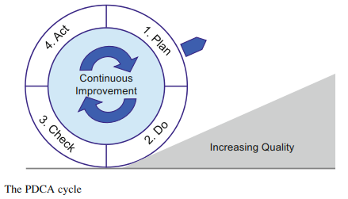
Pdca cycle

Slide 16
Total Quality Management
TQM is a holistic management approach toward quality management and, in particular, continuous improvement within an organization.
The TQM approach was mainly developed in the context of industrial production processes.
Although classic production processes and software development processes differ, it was possible to transfer basic TQM concepts to the domain of software development

Slide 17
objective of TQM
The objective of TQM is to have an organization achieve long-term success by focusing on customer satisfaction. A deﬁnition highlighting these characteristics of TQM is provided in Ref. :
“All work is seen as a process and total quality management is a continuous process of improvement for individuals, groups of people, and whole organizations. What makes total quality management different from other management processes is the concentrated focus on continuous improvement. Total quality management is not a quick management ﬁx; it is about changing the way things are done within the organization’s lifetime.”

Slide 18
evolutionary development of TQM
From inspection to quality control, to quality assurance, and ﬁnally to TQM.
In brief, the main focus of an inspection was to identify and sort out products with defects. Quality control introduced a broader view of quality and provided the ﬁrst methods (e.g., product testing, basic quality planning) for improving quality.
Quality assurance then started to focus on the prevention of defects and on statistical process control.
Finally, TQM took a holistic approach to the subject of quality.
“Total” means that customers, employees across all departments and the overall organizational environment need to be considered.
“Quality” refers to quality of the products, processes, and the organization.
Management relates to leadership and goals with respect to the other two aspects

Slide 19
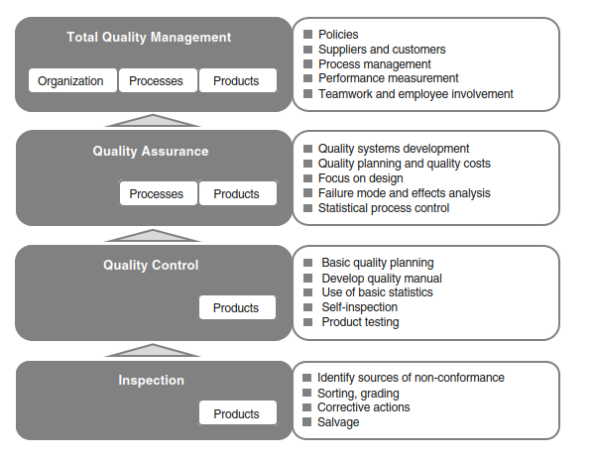
Evolution of the TQM approach

Slide 20
Kaizen
The Japanese word “Kaizen” stands for “improvement” and was adopted in business to describe the philosophy of continuous improvement.
The Kaizen philosophy includes continuous improvement in manufacturing activities, business activities, or even all aspects of life depending on the speciﬁc context of usage.

Slide 21
Kaizen
Kaizen is based on the following ﬁve elements:
– Quality planning
– Teamwork
– Personal discipline and responsibility
– Involvement and suggestions for improvement
– Quality circles.
Kaizen can be characterized as an omnipresent continuous process of evolutionary improvement that aims at eliminating waste and inefﬁciency and furthermore strives toward standardization

Slide 22
Six Sigma
Six Sigma (6s) is widely associated with highly efﬁcient, customer-focused companies that are able to reduce their costs while increasing customer satisfaction.
Six Sigma has its origins in statistics, as the term itself comes from statistics and Sigma describes variance.
The main objective of Six Sigma is to reduce variance in processes and prevent defects that interfere with customer satisfaction.
By achieving these goals, it becomes possible to reduce the costs of production processes and, furthermore, to continuously improve quality and achieve high customer satisfaction.

Slide 23
Six sigma
Processes are analyzed by means of statistical methods, and a process operating at the Six Sigma level produces only 3.4 defects per million opportunities.
Every defect leads to certain costs and that there is a factor of approximately 2,000 when comparing the number of defects of level-4 and level-6 processes.
Although Six Sigma comes from statistical analysis and was introduced in manufacturing, by now it has developed into a broader framework that is also applied to software development.

Slide 24
Six Sigma framework
The Six Sigma framework is based on the following aspects:
1. Prevention of defects
2. Reduction of variation
3. Focus on the customer
4. Decision making based on facts
5. Teamwork

Slide 25
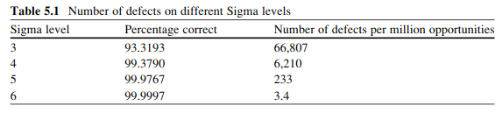
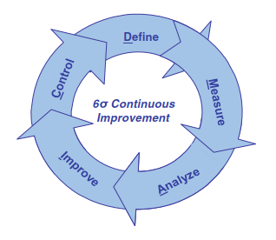
overview of different Sigma levels

Slide 26
The Six Sigma framework contains methodologies for continuous improvement of processes as well as for the design of processes to satisfy Six Sigma requirements.
The Deﬁne Measure Analyze Improve Control (DMAIC) method is used for process improvement

Slide 27
Define Measure Analyze Improve Control (DMAIC)
– Deﬁne: Identify the problem and the customers. Deﬁne and prioritize the customers’ expectations and describe the current process on a high level. Initiate the improvement project.
– Measure: Conﬁrm and quantify the problem by measurement. Measure the steps of the process to collect data about current processes. Revise and clarify the problem statement if necessary. Deﬁne the desired outcome of improvement.
– Analyze: Determine the cause of the problem and identify solutions to decrease the gap between the current performance level and the desired performance level.
– Improve: Prioritize the different available solutions. Then implement those solutions with the highest beneﬁt for reaching the desired improvement.
– Control: Measure the improvements which were achieved and perform the maintenance of the improved process in order to ensure sustainability of the improvement.

Slide 28
Basic Statistics
Quantitative, or statistical, techniques need to be sophisticated to be useful
Pareto analysis for example is very simple
Quantitative techniques do require
measurable data
consistent data collection
defined comparable measurements

Slide 29
Seven Basic Tools of Statistical Process Control
There are seven quantitative tools considered basic to statistical process or quality control.
Histograms
Cause and effect diagrams
Check sheets
Pareto diagrams
Run charts
Control charts
Scatter diagrams

Slide 30
Controlling Special Causes of Variation
An important concern is identifying variations in performance that are not within the normal range of process performance
“extraordinary” events outside the bounds of process capability
Identify the problem in the process
Control chart with special causes

Slide 31
Taking Corrective Action
Quantitative Process Management focuses on the process
Process capability is quantitatively known
When performance falls outside the limits:
Identify the reason
Take corrective action when appropriate
Voice of the Process
Control chart with special causes

Slide 32
cause and effect diagram
A cause and effect diagram is a visual tool used to logically organize the many possible causes for a specific problem or effect by displaying them graphically. The term “cause and effect diagram” is often used interchangeably with fishbone diagram and is used successfully in continuous improvement activities across many industries and businesses.

Slide 33
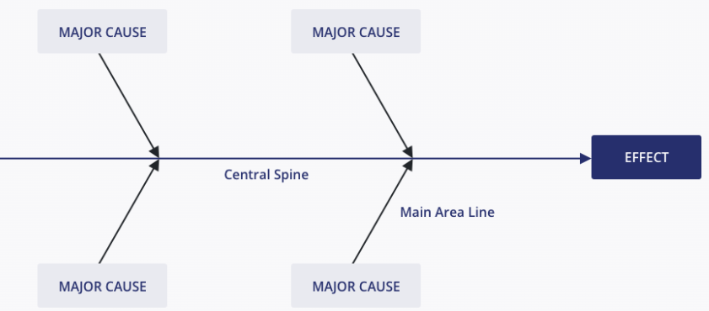

Slide 34
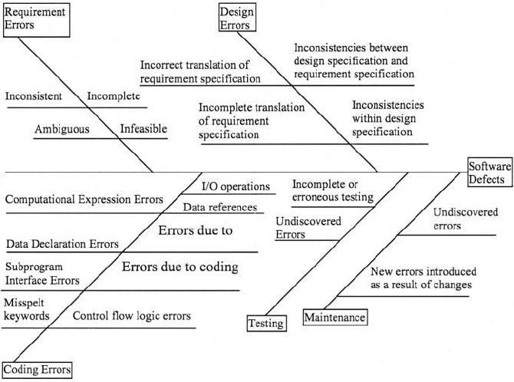
Example

Slide 35
Pareto chart
A Pareto Chart is a statistical chart which orders the causes or problem in the descending order of their frequency and their cumulative impact. Histogram chart is used inside the Pareto chart to rank the causes. This chart is also known as Pareto Diagram.
When To Use Pareto Chart? These are used in cases like,
When there is a lot of data and needs to be organized.
When you want to communicate the top issues to stakeholders.
When there is a need to prioritize tasks.
When the relative importance of data needs to be analyzed.

Slide 36
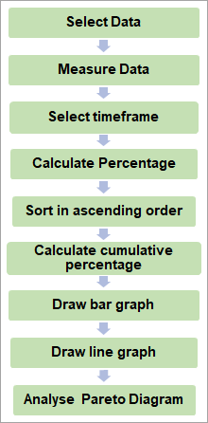
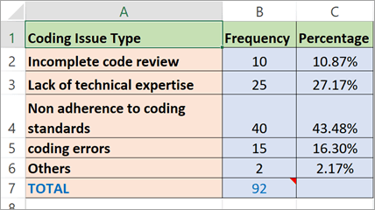
Steps To Create a Pareto Chart
Notes:
Ref: https://www.softwaretestinghelp.com/pareto-analysis-and-pareto-chart

Slide 37
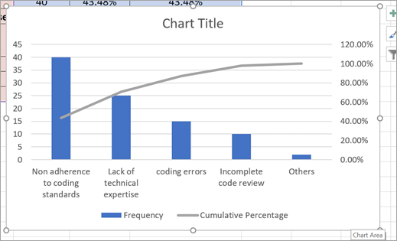
Pareto chart
the first 2 causes contribute to 70% of defects.

